Slide 1
Computer Science
Mr. Eddie

Slide 2

Agenda
Do Now
Tables Part. 2
Activity
Exit Ticket

Slide 3
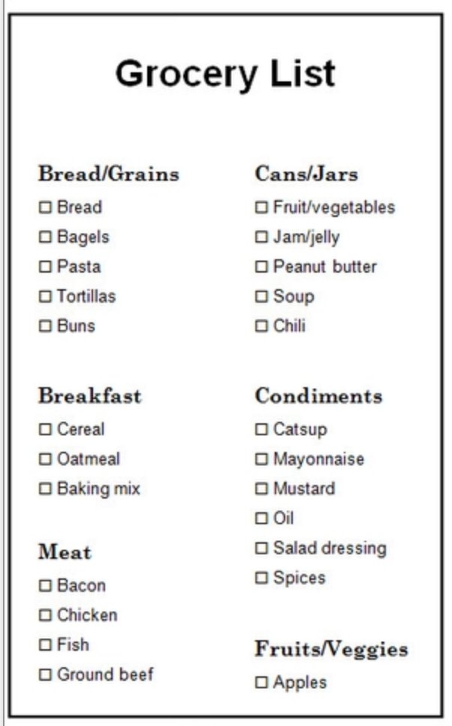
Do Now
Answer the following questions:
Organize the following data using Google Sheets

Slide 4
Unit 2
U2.L2 - Videos & Tables

Slide 5
Objectives
create a simple data table that includes <table> <caption>, <thead>, <tbody>, <tr>, <th> and <td> elements as well as scope attributes.

Slide 6
Exit Ticket

